Slide 1


Slide 2
PERFORMANCE OF MSC Academic Program (COMPUTER SCIENCE) YASHWANTH RAO VARALA BALAJI(1001916698) SRILEKHYABUKKAPATNAM(1002067807) RUBAN ESWARAVELU(1002018133) JAYANTH REDDY GUNDALA(1002067847) UMESH CHANDRA KARAGATLA(1002074938)

Slide 3
Home Page
About Section:
Concise overview of mission, values, and key highlights.
Services Segment:
Various offerings highlighted, focusing on student-centric resources, faculty support, and quality assurance.
Contact Section:
Provides contact information, encourages inquiries for direct interaction.
Blog Section:
Keeps the community informed with relevant updates, events, and insights.
Login Feature:
Grants secure access to personalized areas for students, faculty, and administrators.
Overall Design:
Homepage designed to seamlessly blend informative content with interactive elements, fostering a dynamic and inclusive academic environment.

Slide 4
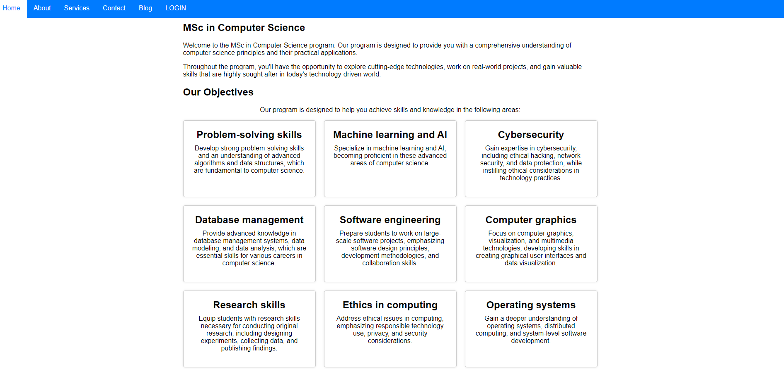

Slide 5
Student Page
Profile Section:
Manage academic information.
Track progress and update personal details.
Courses Segment:
Access detailed course information.
View syllabi, schedules, and assignments.
Tests Section:
Facilitates exam preparation.
Provides access to past exams, study materials, and practice quizzes.
Notifications:
Keeps students informed about updates, deadlines, and announcements.
Chat Feature:
Promotes real-time communication.
Fosters collaboration among students for quick support.

Slide 6
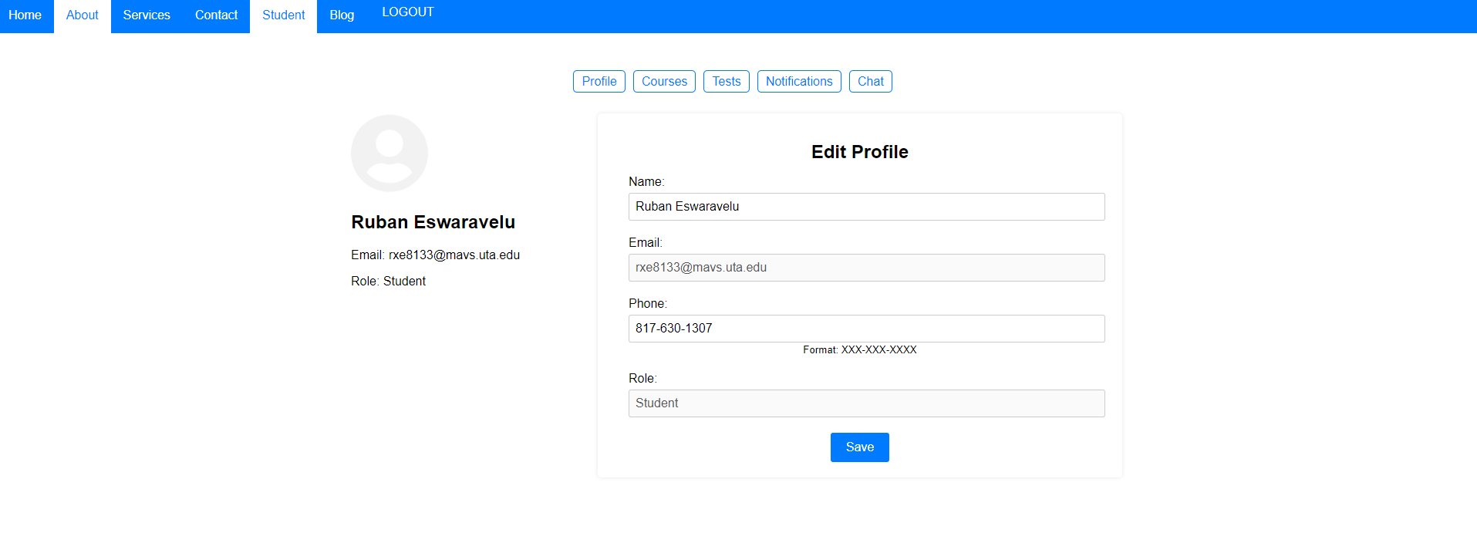

Slide 7
Instructor Page
Profile:
Manage academic credentials and professional details.
Courses:
Organize and present course materials.
Track student progress and manage assignments.
Tests:
Seamlessly create and assess exams.
Notifications:
Stay updated on announcements and administrative matters.
Chat:
Facilitate quick communication, enhancing collaboration.
Students:
Monitor and engage with student performance for a supportive teaching environment.

Slide 8
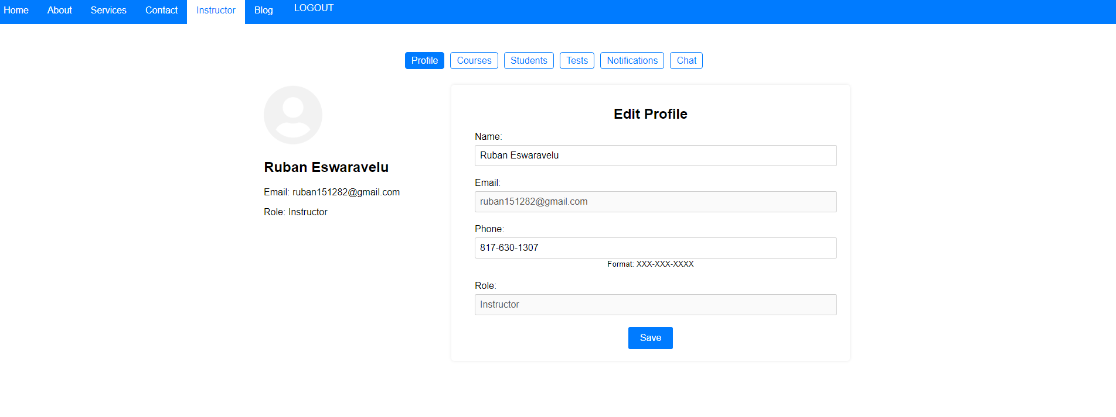

Slide 9
Program Co-ordinator Page
Profile Section:
Manage professional information and roles.
Notifications:
Stay informed of critical updates for timely decision-making.
Chat Feature:
Facilitates real-time collaboration with instructors, administrators, and students.
Students Section:
Provides a comprehensive overview of student performance.
Integrated Approach:
Ensures effective communication, coordination, and oversight.

Slide 10
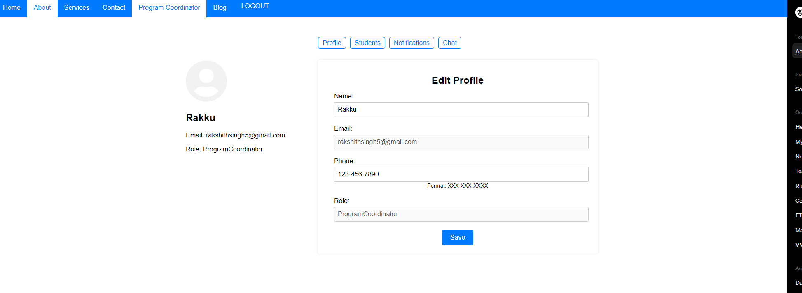

Slide 11
Admin Page
Profile Section:
Oversee professional details and responsibilities.
Centralized hub for administrators.
Notifications:
Stay informed about critical updates.
Facilitates swift decision-making.
Chat Feature:
Streamlines communication among administrative staff.
Ensures effective collaboration.
Policies Section:
Outlines and enforces institutional guidelines.
Contributes to consistency and adherence to standards.
Manage Users Functionality:
Efficiently handle user accounts.
Ensures secure access and streamlined user management processes.
Integrated Suite:
Empowers administrators.
Maintains program efficiency and upholds administrative standards effectively.

Slide 13
Quality Assurance Page
Profile Section:
Manage professional details and roles within the quality assurance framework.
Notifications:
Stay informed with real-time updates, ensuring prompt responses to quality-related matters.
Chat Feature:
Foster collaboration among QA members and stakeholders, promoting efficient communication.
Policies:
Outline established standards and guidelines to ensure consistency and adherence to quality benchmarks.
Recommendations:
Provide a platform for continuous improvement, allowing QA personnel to offer insights and enhancements.
Integrated Approach:
Contributes to maintaining and improving high academic standards through a holistic and collaborative quality assurance strategy.

Slide 14
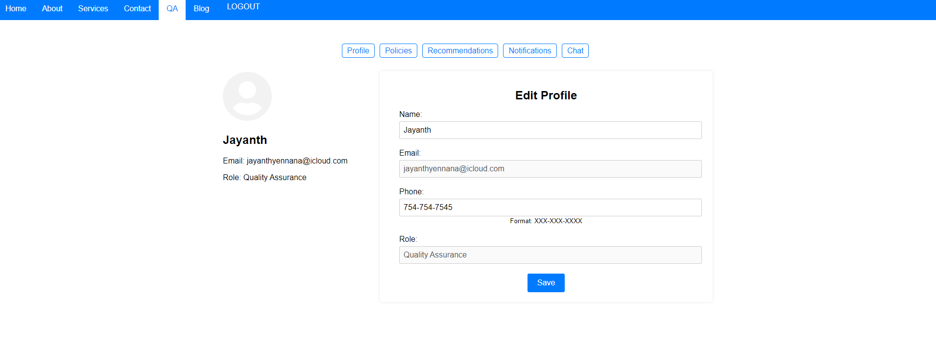

Slide 15
Implemntation
Frontend (React):
Develop React components for user dashboards, profile management, and dynamic content rendering.
Utilize React Router for navigation and state management for handling user data.

Slide 16
Backend (Laravel):
Create RESTful APIs using Laravel to serve data to the React frontend.
Use Laravel Eloquent ORM for database interactions and implement real-time communication with Laravel Echo.

Slide 17
Features Implementation:
Implement chat functionality and notifications using real-time communication libraries.
Set up endpoints for courses, tests, blog posts, and user-related information.
Manage user authentication securely with Laravel Passport and enforce roles and permissions.
Policy and Recommendation:
Enforce policies and guidelines using Laravel middleware.
Create endpoints for applying and managing recommendations for continuous improvement.
User Management:
Develop user management functionality, including roles and permissions.
Ensure secure admin-level functionalities and protect user data with HTTPS.
Overall Architecture:
Maintain a clear separation of concerns with React for frontend and Laravel for backend.
Implement secure communication between frontend and backend, emphasizing data protection.

Slide 18
Thank you

